Slide 1
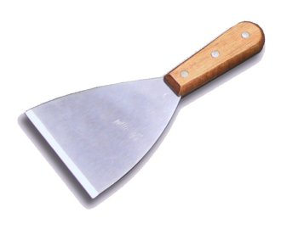

Intro to Web Scraping
Albie Brown ‘16 and Will Newman
from

Slide 2
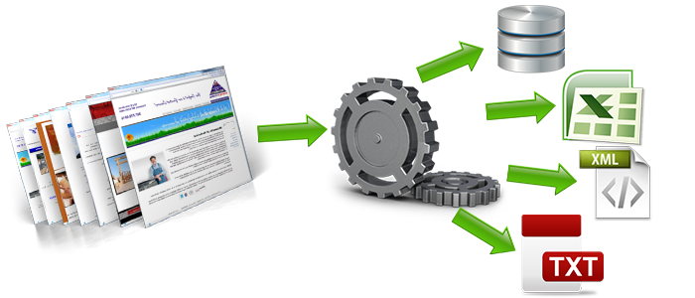
What is scraping?
Image: http://webdata-scraping.com/web-scraping-trending-technique-in-data-science/

Slide 3
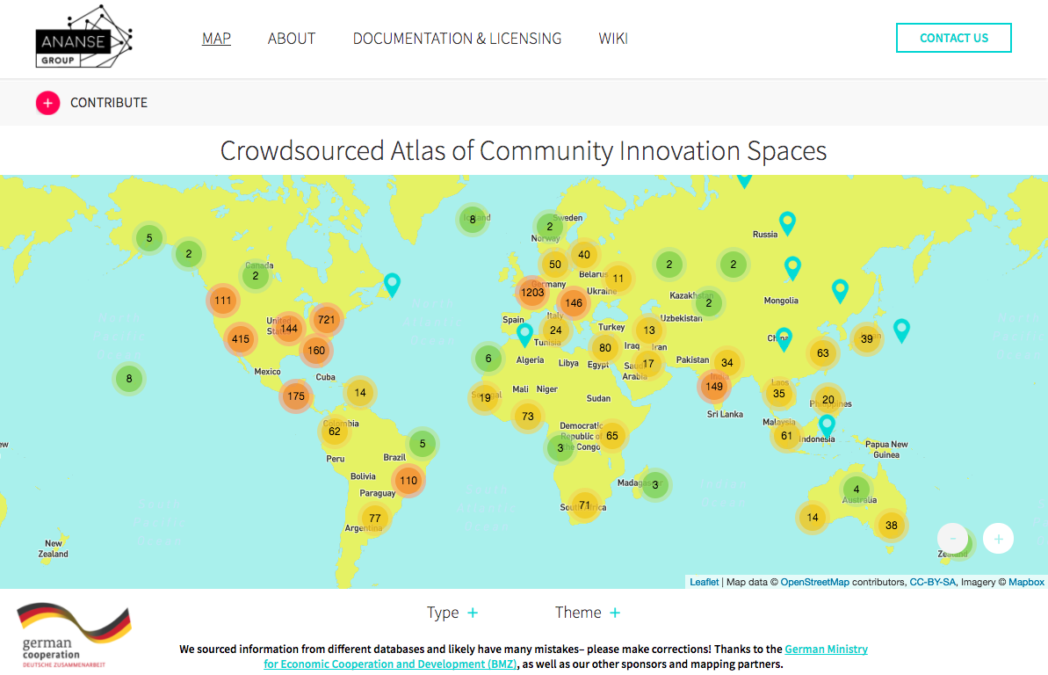
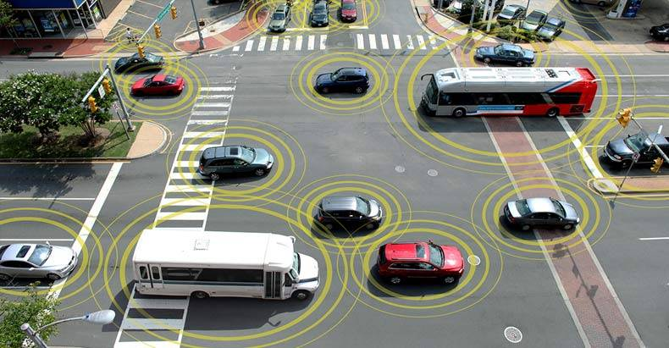
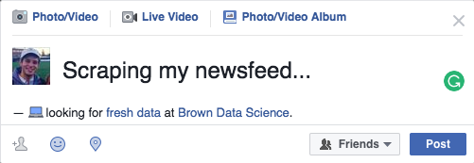


Uses
Atlas of Innovation
Vehicle Location Trends
Social Media
Property Tax Records
Images: http://thefreethoughtproject.com/driving-behavior-free-download-government-mandate-connected-cars/, https://www.providenceri.com/assessor, http://cliparts.co/question-marks

Slide 4
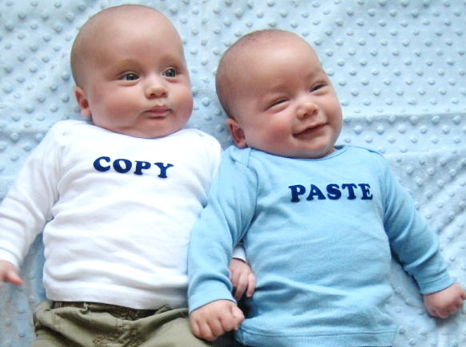
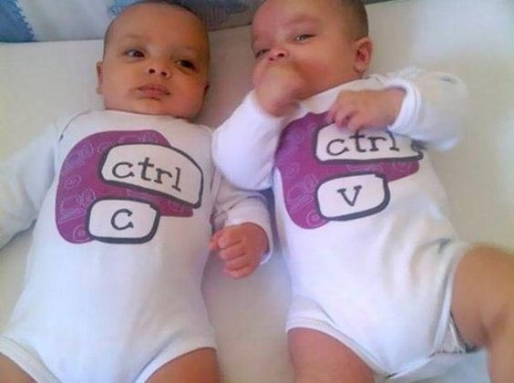
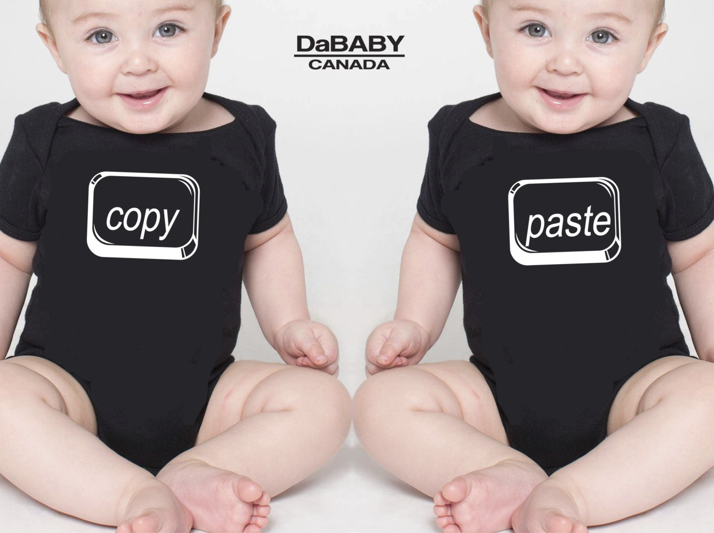

Method 1: Copy + Paste
Images: https://www.etsy.com/listing/223539922/funny-twin-outfits-copy-paste-twin, https://www.pinterest.com/pin/434104851559735489/, http://lifesapizzapie.info/2012/08/, https://www.pinterest.com/pin/353251164497601186/

Slide 5

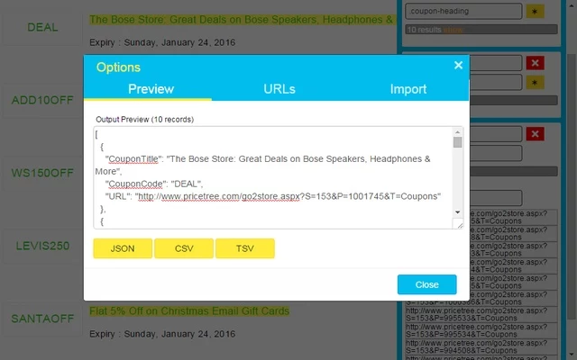
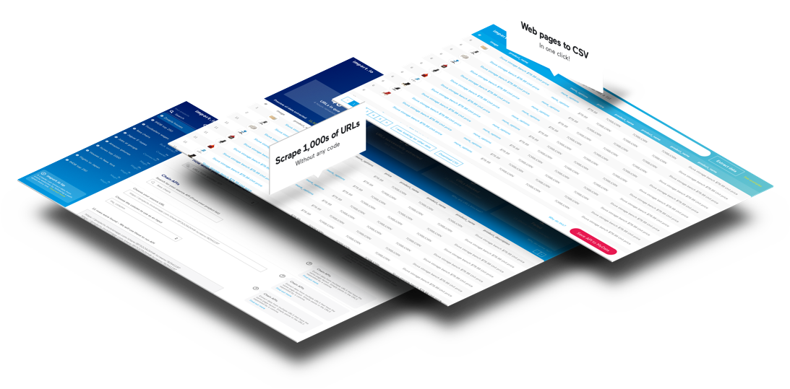
Method 2: Software
Chrome Extension
import.io*
*free student plan
Images: https://chrome.google.com/webstore/detail/advanced-web-scraper/gpolcofcjjiooogejfbaamdgmgfehgff?hl=en-US
http://import.io

Slide 6


Method 3: DIY
+
Images: https://singbookswithemily.wordpress.com/2015/03/05/beautiful-soup-a-singable-illustrated-poem-from-alice-in-wonderland/
https://realpython.com/learn/python-first-steps/

Slide 7

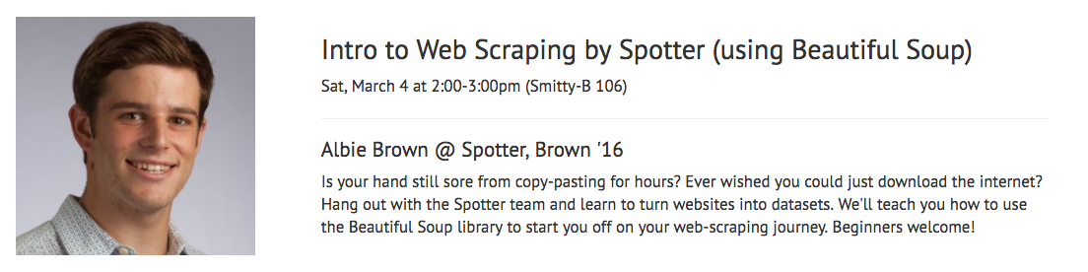
Step 1: Pick a web target!
Images: https://i.ytimg.com/vi/hlLUa1-1SUk/maxresdefault.jpg

Slide 8

Step 2: Get permission
Read this: http://robertorocha.info/on-the-ethics-of-web-scraping/
Image: https://www.promptcloud.com/blog/is-data-scraping-ethical

Slide 9

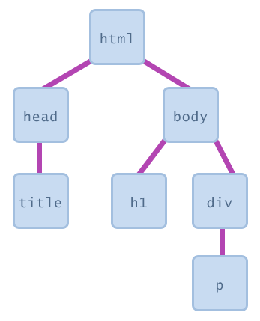
Step 3: Inspect the DOM
Images: https://i.kinja-img.com/gawker-media/image/upload/t_original/lxblomme8ztucwzaavdh.jpg
https://courses.cs.washington.edu/courses/cse190m/07sp/lectures/slides/08-dom.html

Slide 10
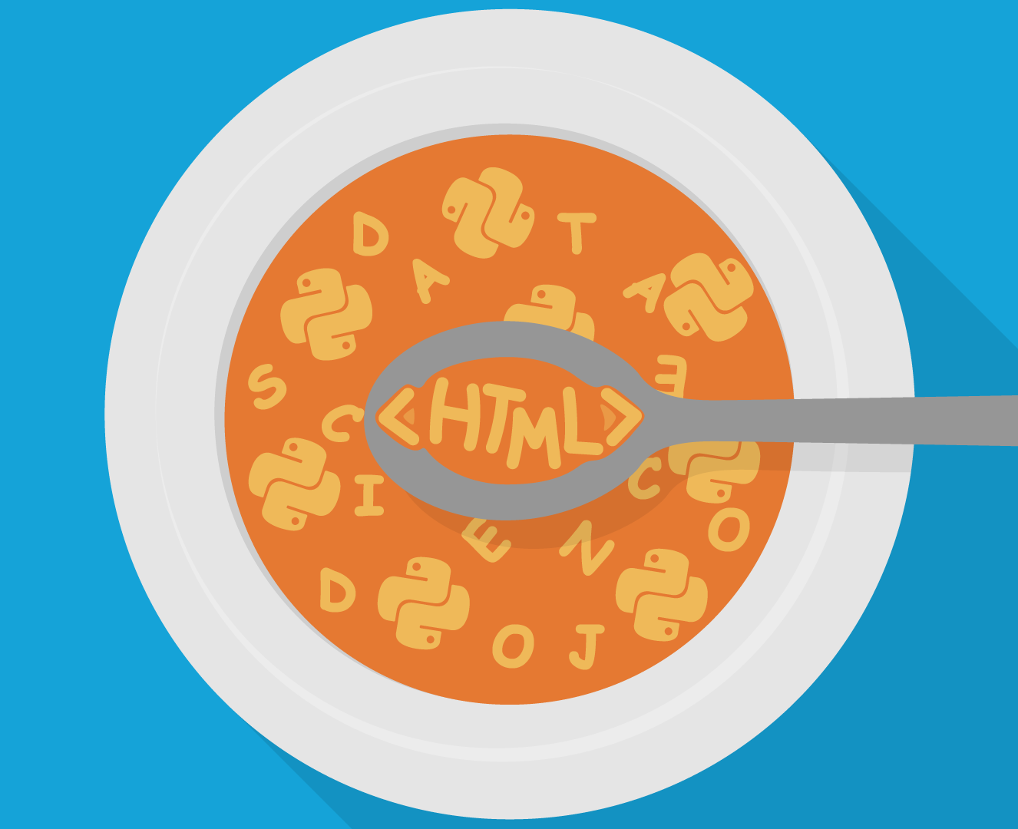
Step 4: Beautiful Soup
https://github.com/albiebrown/Scraping-Workshop
Image: https://static.datasciencedojo.com/wp-content/uploads/PythonBeautifulSoup-04.png

Slide 11



Q&A
Albie Brown
hello@parkwithspotter.com
/ParkWithSpotter
@ParkWithSpotter
@ParkWithSpotter

